Slide 1

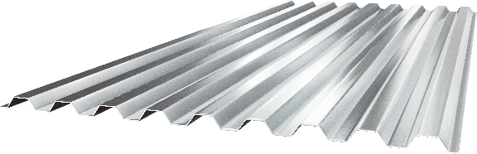
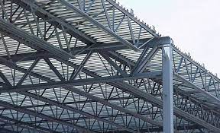
JOIST & DECK DETAILING AND ENGINEERING SERVICES
www.rydbergengineering.com

Slide 2
ABOUT US
Rydberg Engineering LLC has been a major player in the Architecture, Engineering and Construction design industry for over two decades.
Our teams specialize in providing engineering, architectural services and solutions. In doing so we empower our clients in the AEC sector to improve their efficiencies, support their global footprint and improve their competitiveness.
As a result, we have emerged as a partner-of-choice for leading international companies by leveraging technology, domain knowledge, our robust work planning and effective communication skills to ensure the success of our clients’ projects.
We not only deliver drawings, but also provide a professional assessment, consultancy, suggestions and the desire to improve each project. We pride ourselves in our team of highly trained individuals with years of detailing and engineering experience.
We would very much like to work with your company in providing joist, deck, and other detailing and engineering services.
One Goal, One Passion – Synchronize with the Future
www.rydbergengineering.com

Slide 3

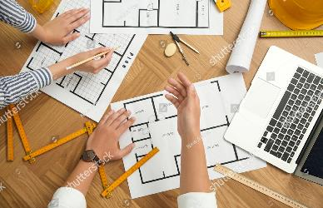
OUR Company and Services
Our team has 10+ detailers experienced in Joists & Deck
Follow OSHA, SDI, SJI Standards
Our Engineers are licenced in the US & Canada
Detailed over 100 Joist & Deck projects
All sizes of projects are welcomed!
PRICING among the best in the market
Also provide BIM Coordination
Estimating Services Available
One Goal, One Passion – Synchronize with the Future
www.rydbergengineering.com

Slide 4
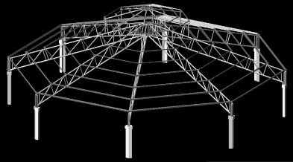
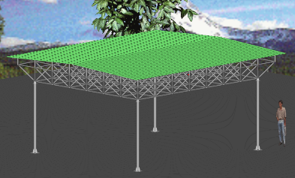
World Class Experience
  We have successfully detailed and engineered many different types of projects including:
  Office Spaces
  Sport Arenas and Stadiums
  Airports
  Warehouses
  Schools and Universities
  High-rise Residential Apartments
  Churches
One Goal, One Passion – Synchronize with the Future
www.rydbergengineering.com

Slide 5
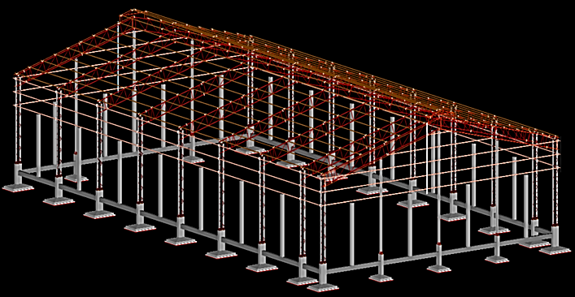


STANDARDS
Our teams are experienced with the standards provided by the Steel Deck Institute (SDI) and Steel Joist Institute (SJI)
One Goal, One Passion – Synchronize with the Future
www.rydbergengineering.com

Slide 6
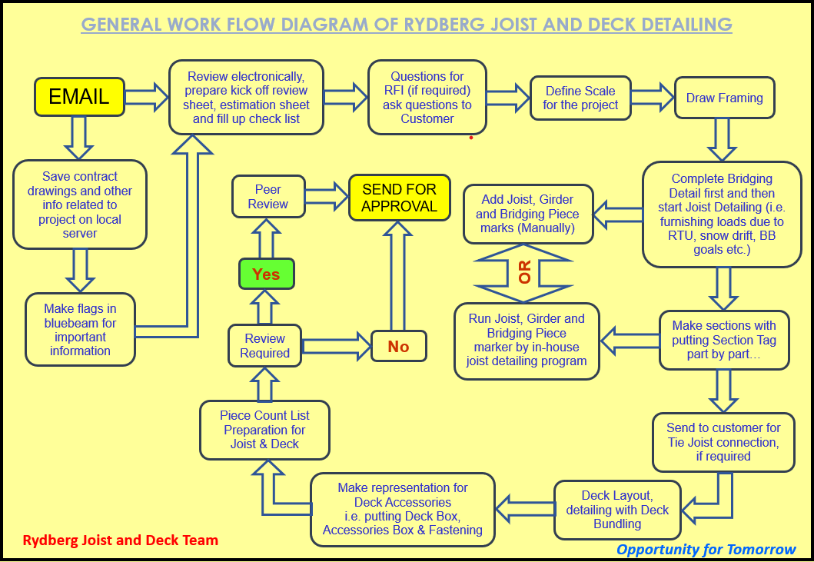
OUR AWARD WINNING PROCESS
One Goal, One Passion – Synchronize with the Future
www.rydbergengineering.com

Slide 7
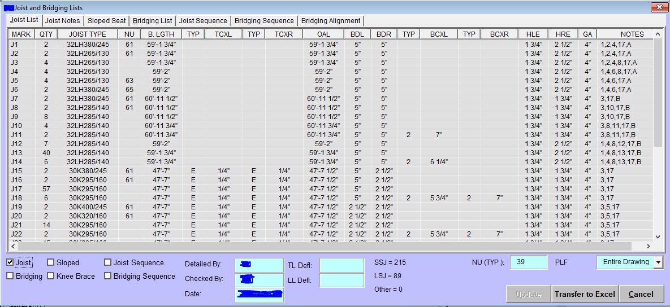
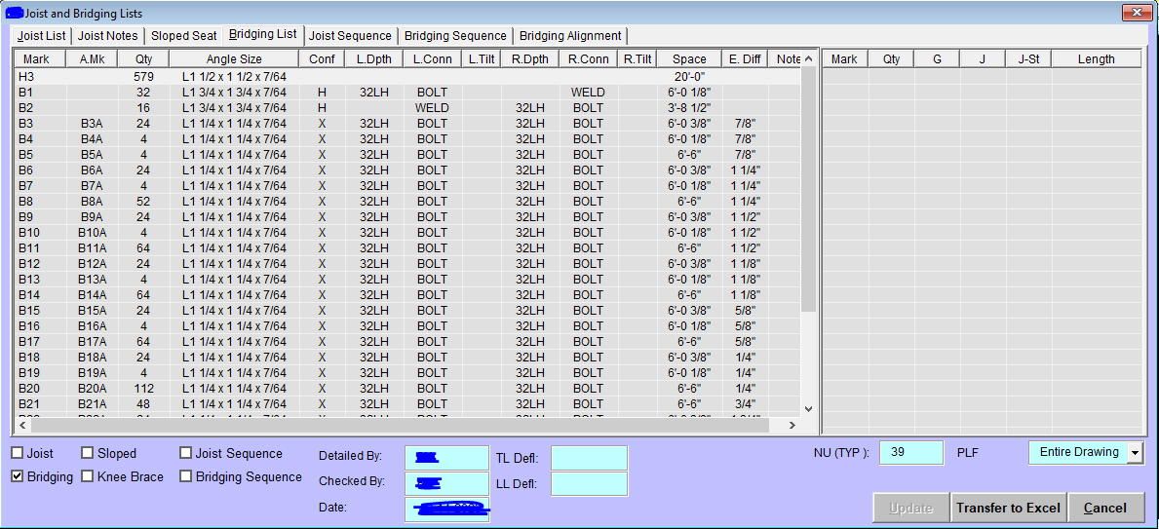
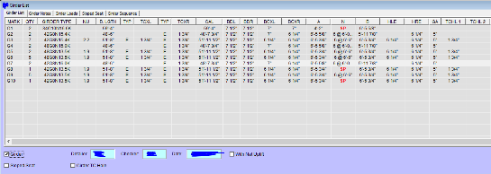
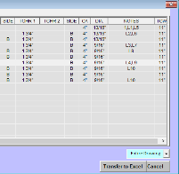
Custom Joist Detailing Program
For detailing joist/deck projects we use our CAD supported in-house joist detailing program. This program produces error free drawing and bills of material. Once framing is completed, all joists, girders and bridging related information is in your finger tips with this program.
One Goal, One Passion – Synchronize with Future
www.rydbergengineering.com

Slide 8
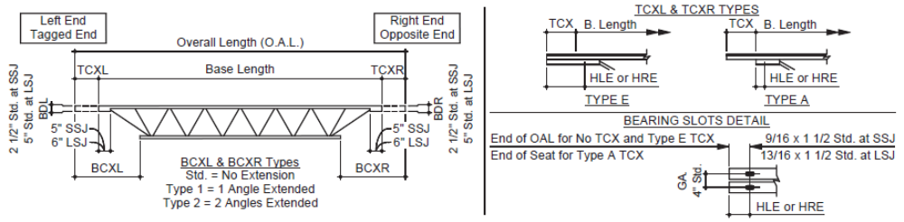
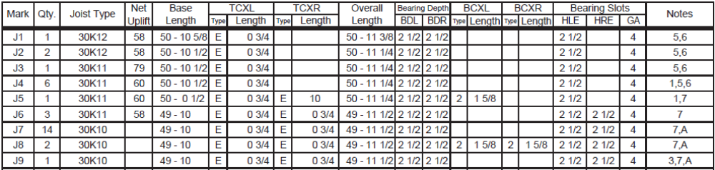
JOIST BILL OF MATERIAL
BASELINE METHOD
One Goal, One Passion – Synchronize with Future
www.rydbergengineering.com

Slide 9
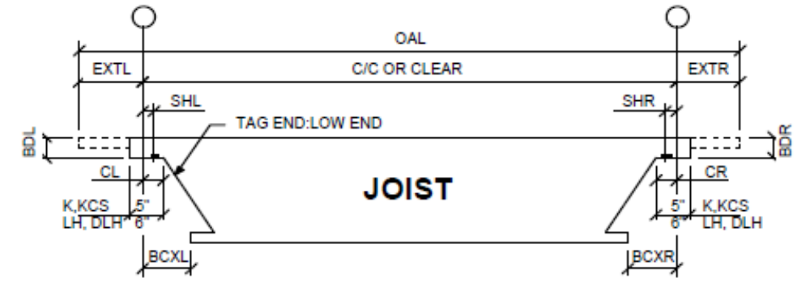
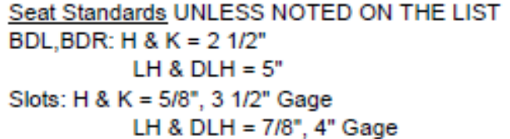
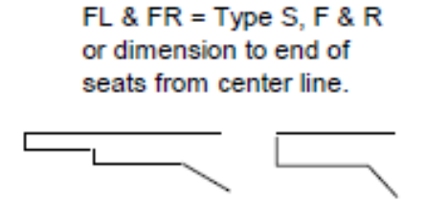


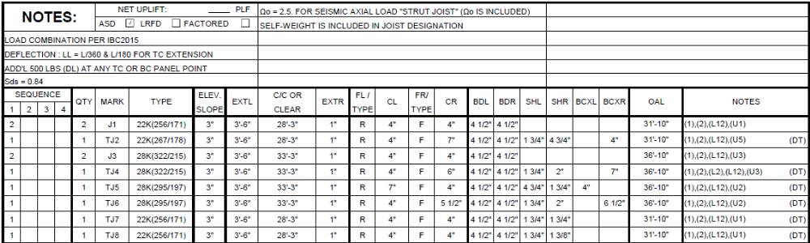
JOIST BILL OF MATERIAL
CENTERLINE METHOD
One Goal, One Passion – Synchronize with Future
www.rydbergengineering.com

Slide 10
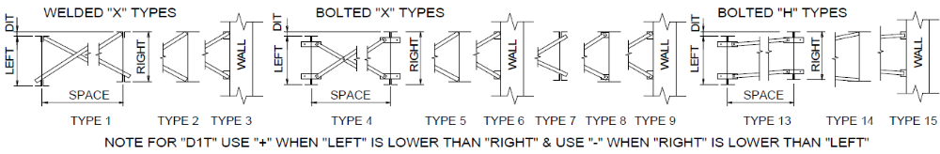
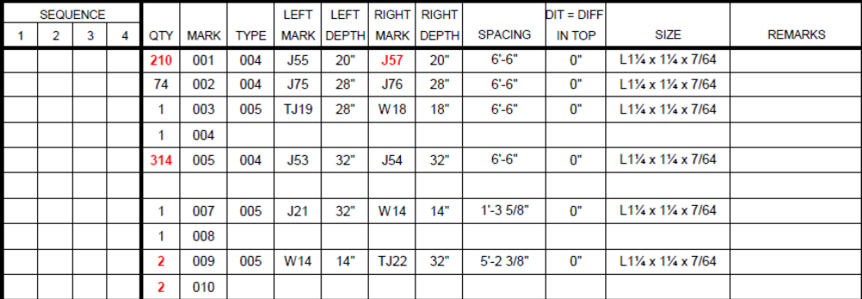
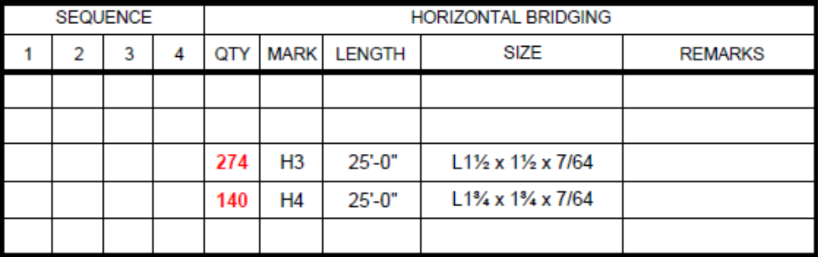
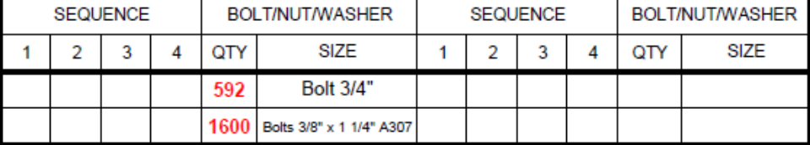
BRIDGING BILL OF MATERIAL
DIFFERENT TYPES OF BRIDGING LISTS
One Goal, One Passion – Synchronize with Future
www.rydbergengineering.com

Slide 11
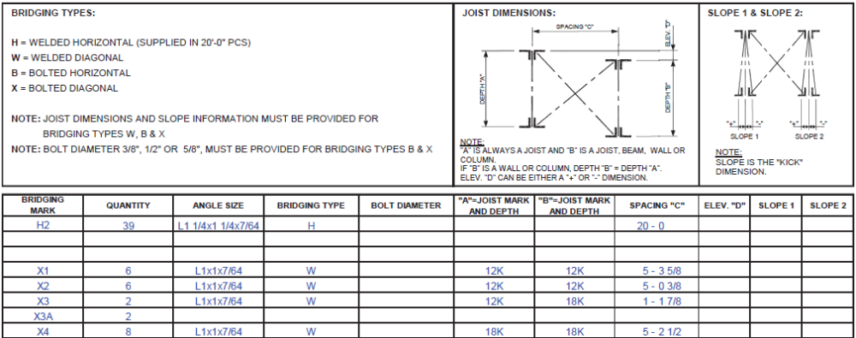
BRIDGING BILL OF MATERIAL
DIFFERENT TYPES OF BRIDGING LISTS
One Goal, One Passion – Synchronize with Future
www.rydbergengineering.com

Slide 12
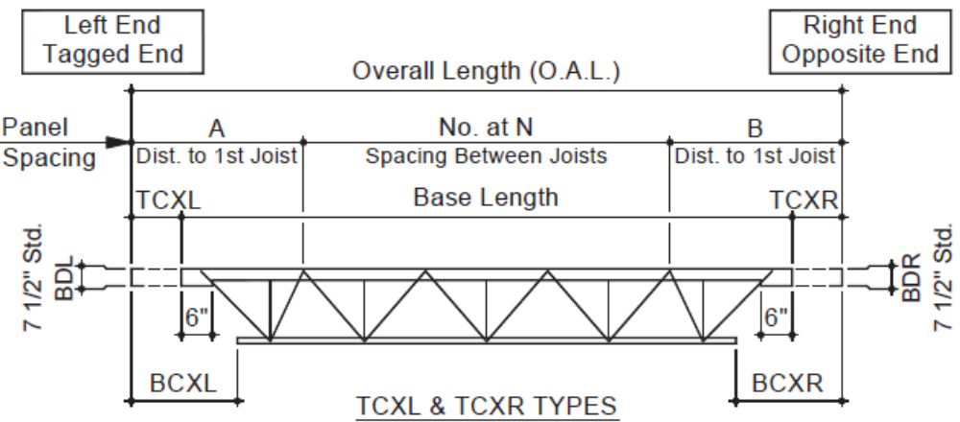
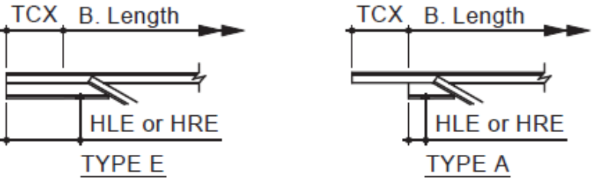
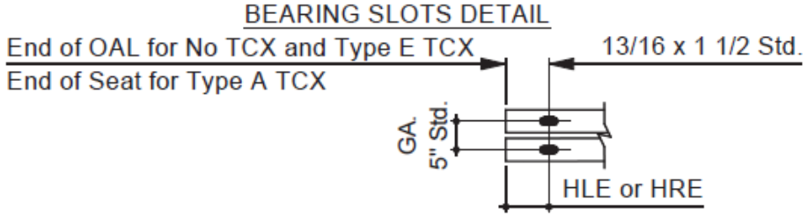
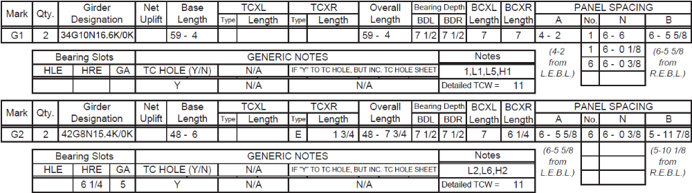
GIRDER BILL OF MATERIAL
BASELINE METHOD
One Goal, One Passion – Synchronize with Future
www.rydbergengineering.com

Slide 13
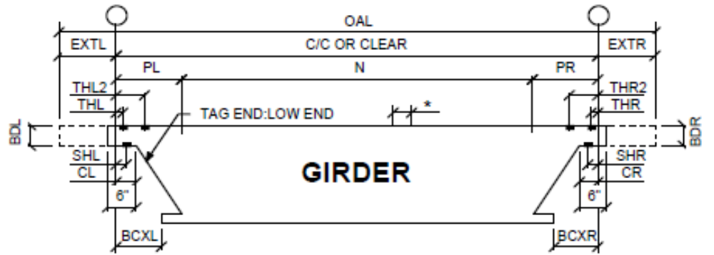
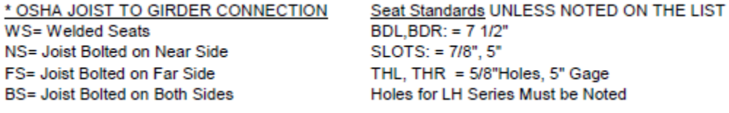
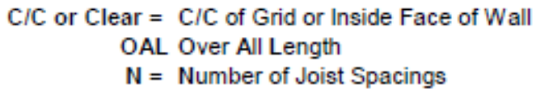
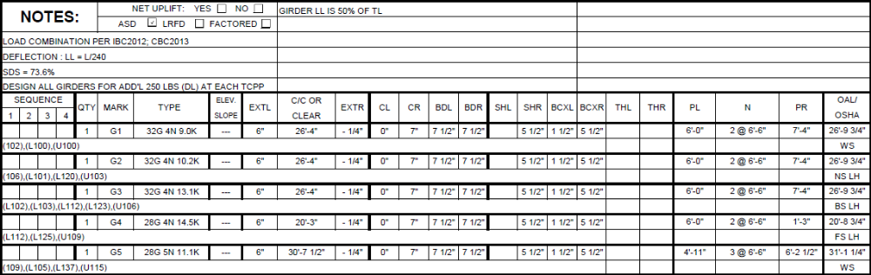
GIRDER BILL OF MATERIAL
CENTERLINE METHOD
One Goal, One Passion – Synchronize with Future
www.rydbergengineering.com

Slide 14


OUR SATISFIED CLIENTS
We have added 30+ clients since 2018, and still growing…..
In our list of satisfied clients
Epic Steel - Cleveland, OHIO
Little Washington Fabricators - Christiana, PA
Stateline Fabricators, LLC- Harmony, NJ
Fabhar Corporation- Princeton, TX
Universal Steel Crafts- Denver, Colorado
LV Iron & Steel – Las Vegas, NV
American Steel- Greenfield, NH
WAG Steel- Washington, VA
One Goal, One Passion – Synchronize with Future
www.rydbergengineering.com

Slide 15
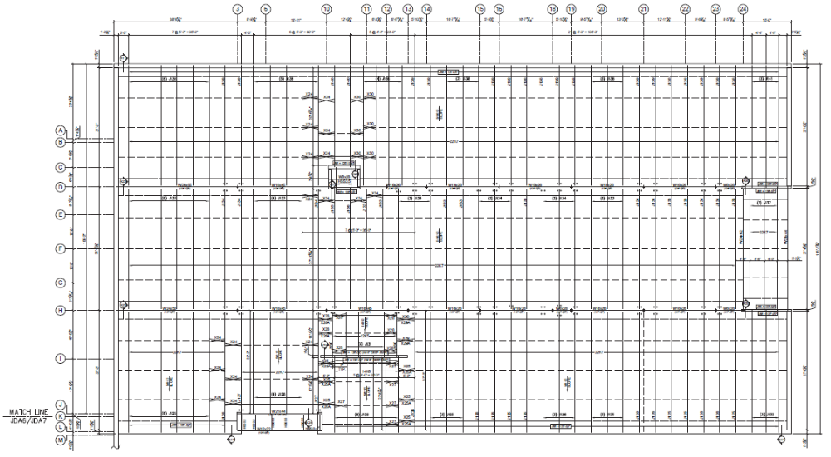
Crosby elementary – oh
JOIST & DECK SCHOOL PROJECT
One Goal, One Passion – Synchronize with Future
www.rydbergengineering.com

Slide 16
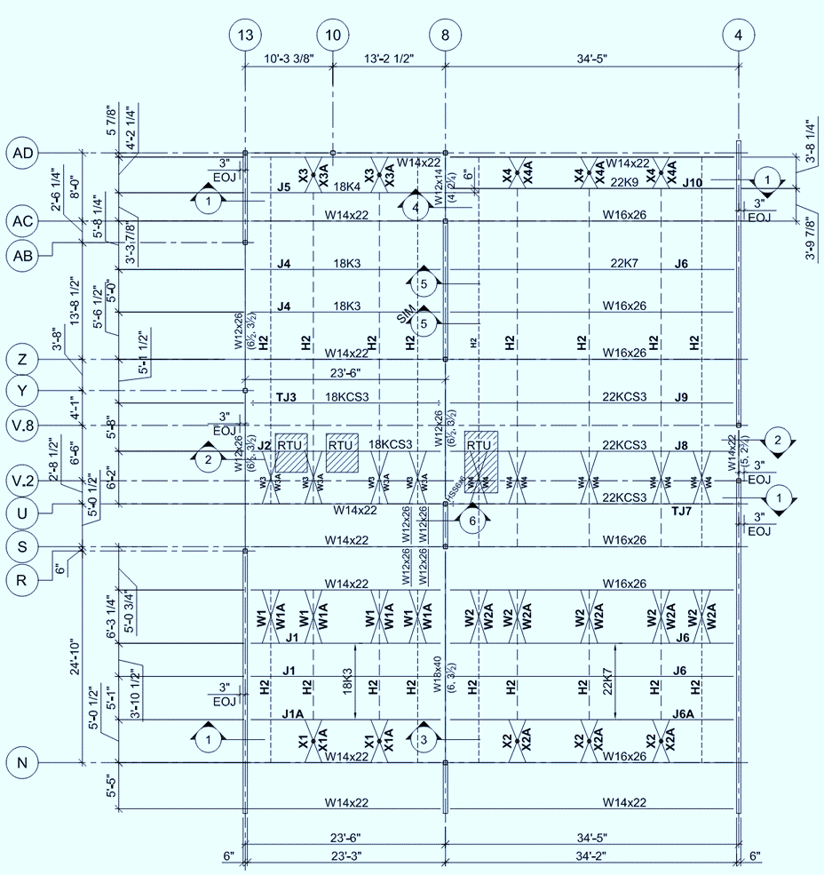
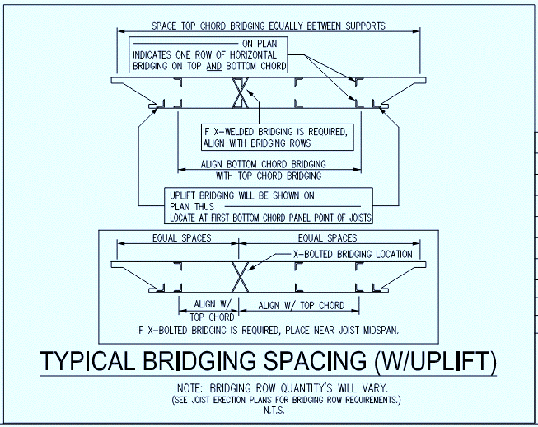
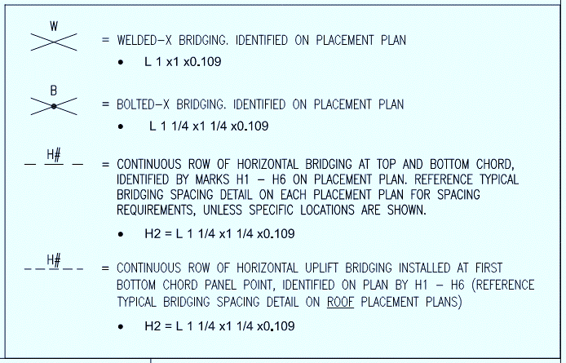
ARBOUR SUARE – TX
JOIST PROJECT
One Goal, One Passion – Synchronize with Future
www.rydbergengineering.com

Slide 17
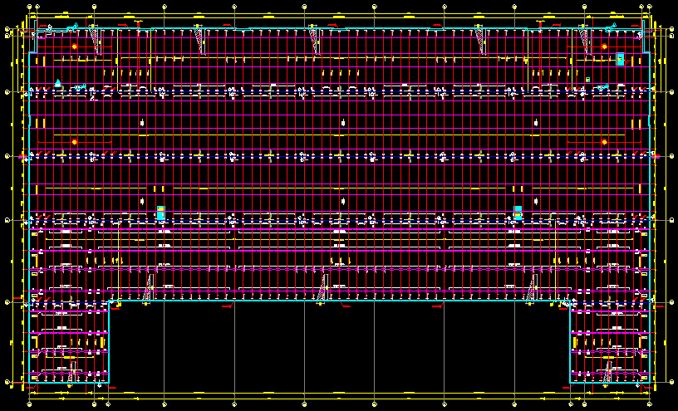
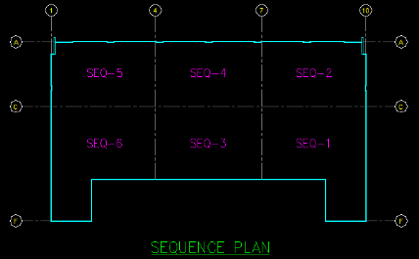
2240W 75TH ST OFFICE – IL
JOIST WAREHOUSE PROJECT
One Goal, One Passion – Synchronize with Future
www.rydbergengineering.com

Slide 18
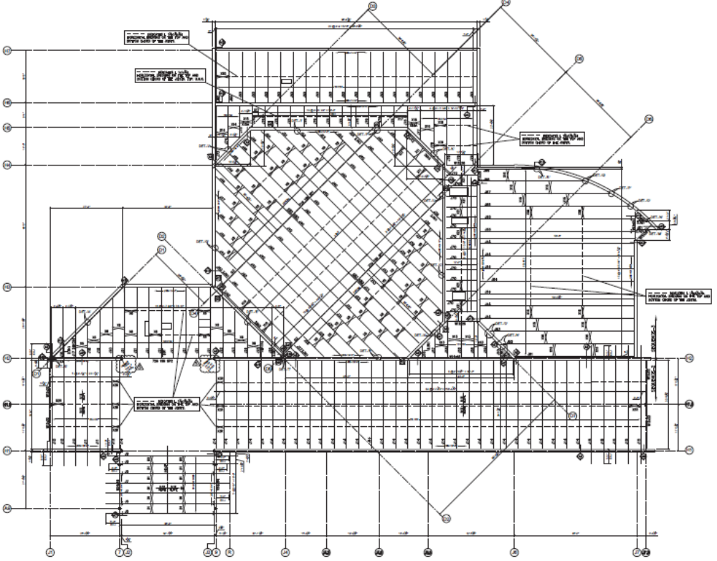
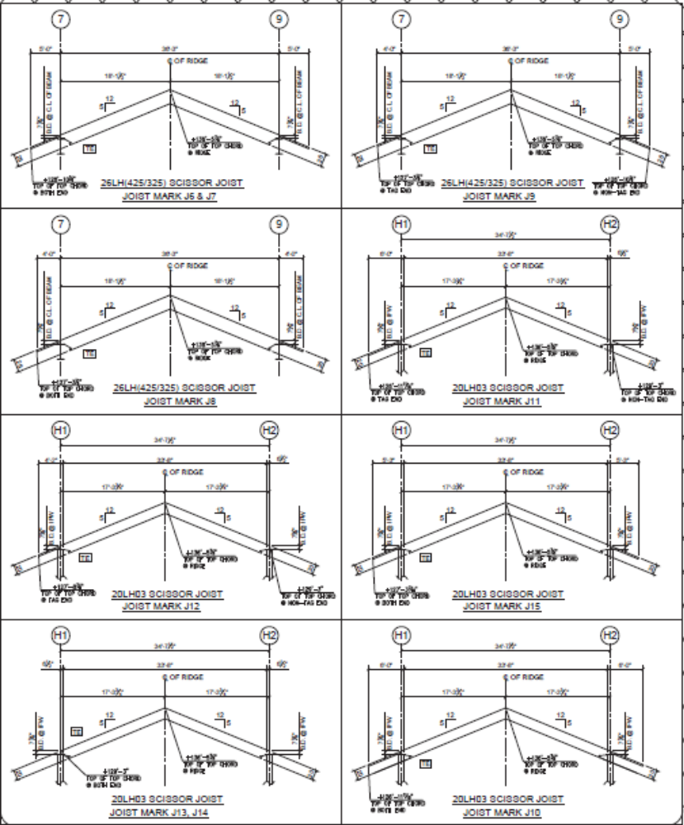
CHRIST CHURCH – WI
CHURCH PROJECT
One Goal, One Passion – Synchronize with Future
www.rydbergengineering.com

Slide 19
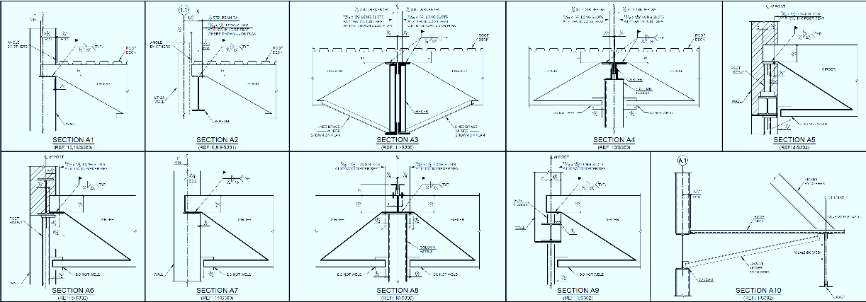
SAMPLE
JOIST SECTIONS
One Goal, One Passion – Synchronize with Future
www.rydbergengineering.com

Slide 20
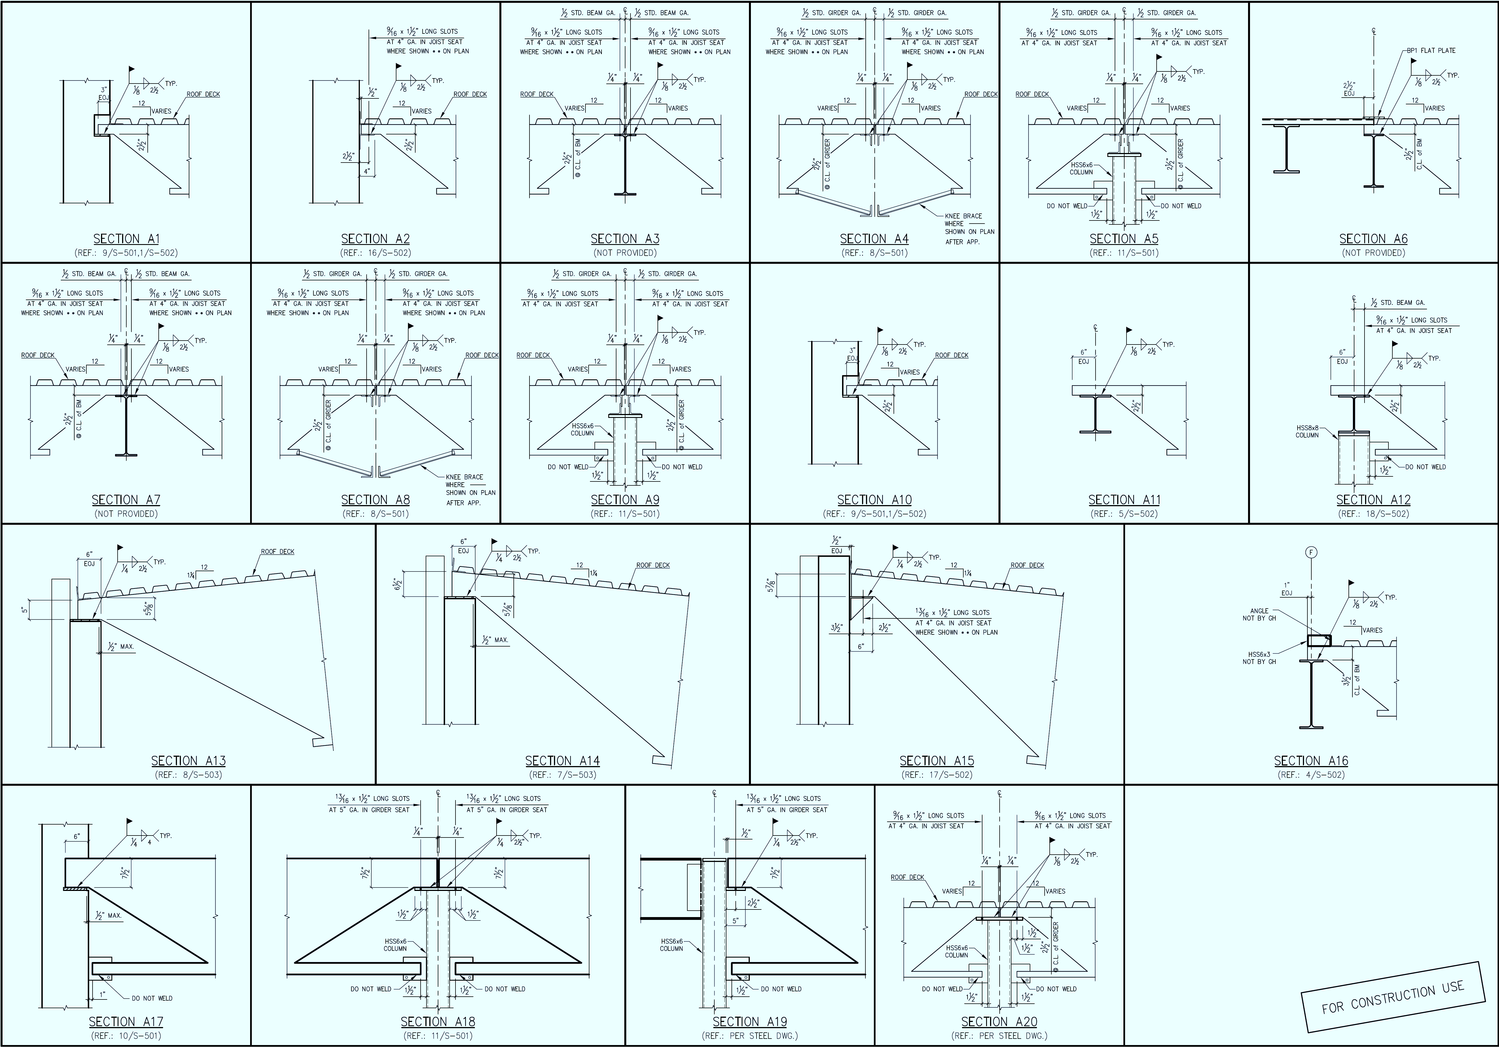
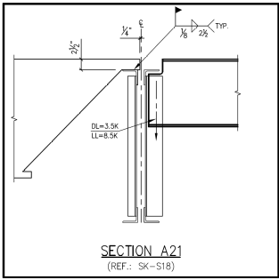
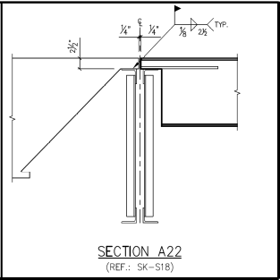
JOIST SECTIONS
One Goal, One Passion – Synchronize with Future
www.rydbergengineering.com

Slide 21
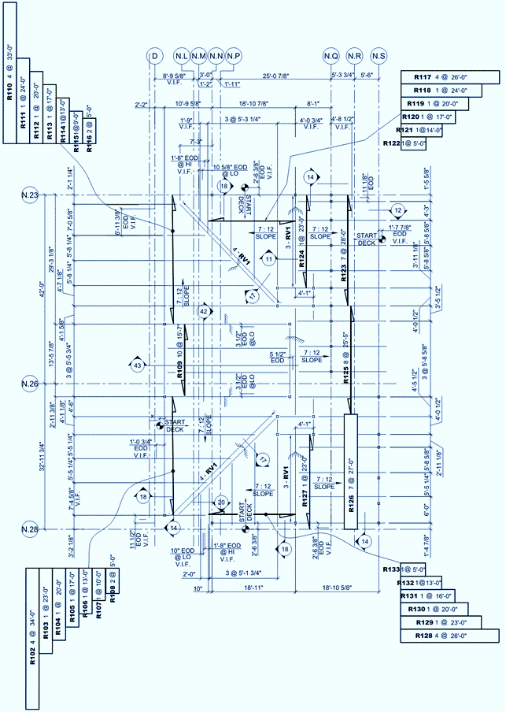
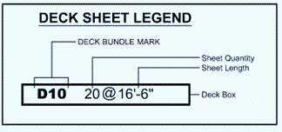
SOUTHERN METHODIST UNIVERSITY
SLOPED ROOF DECK PROJECT
One Goal, One Passion – Synchronize with Future
www.rydbergengineering.com

Slide 22
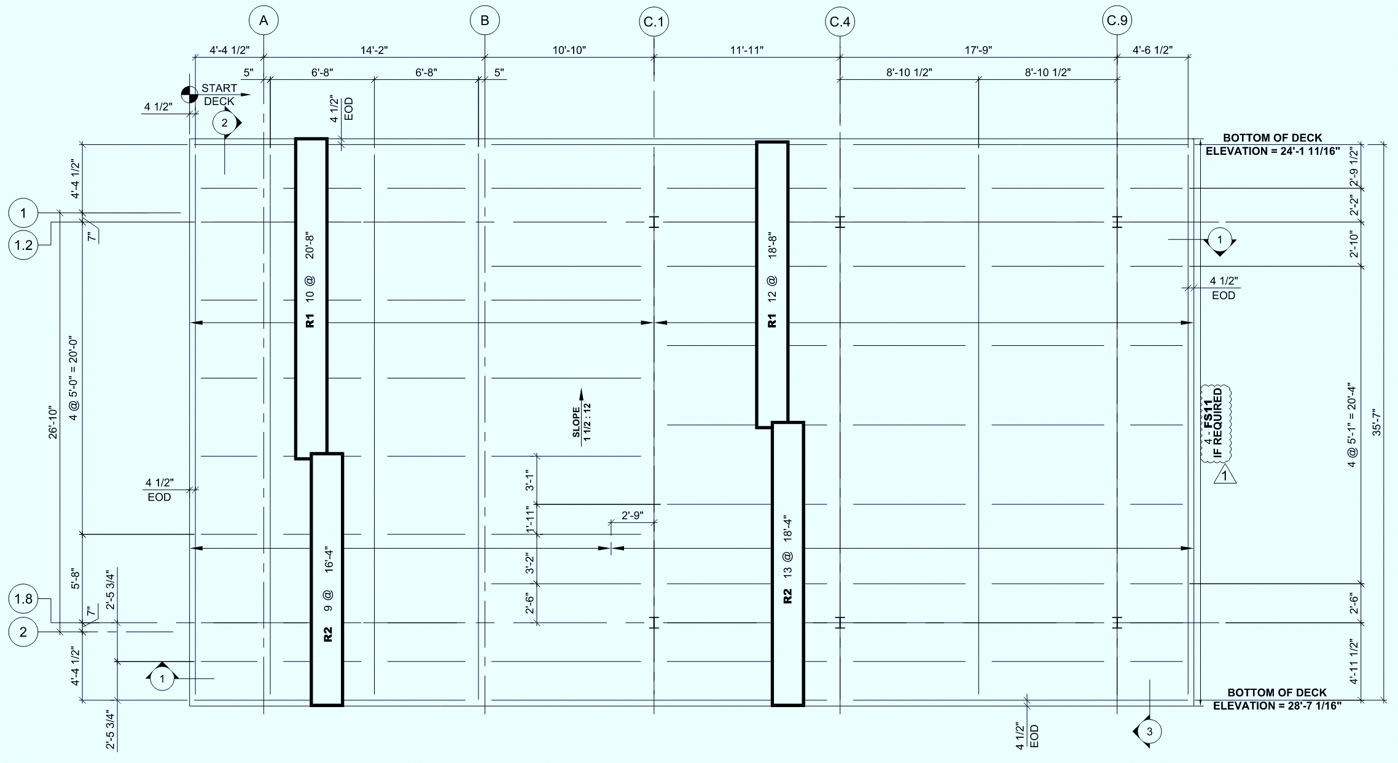
Masport- Pier park phase 2
QUALITY ROOF DECK DRAWINGS
One Goal, One Passion – Synchronize with Future
www.rydbergengineering.com

Slide 23
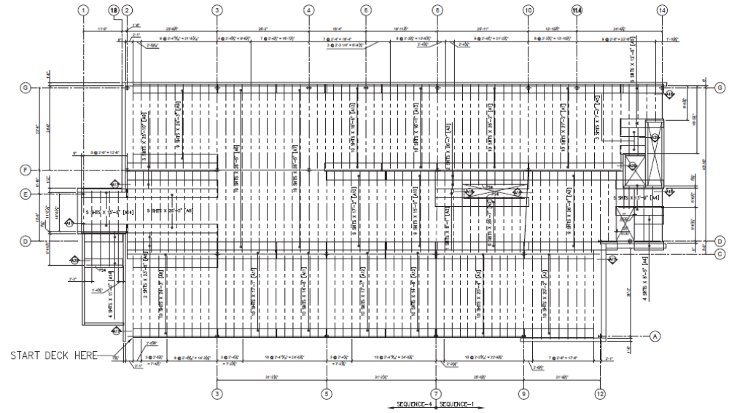
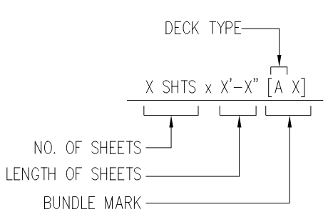
FKC MALLARD CREEK, CHARLOTTE, NC
QUALITY ROOF DECK DRAWINGS
One Goal, One Passion – Synchronize with Future
www.rydbergengineering.com

Slide 24
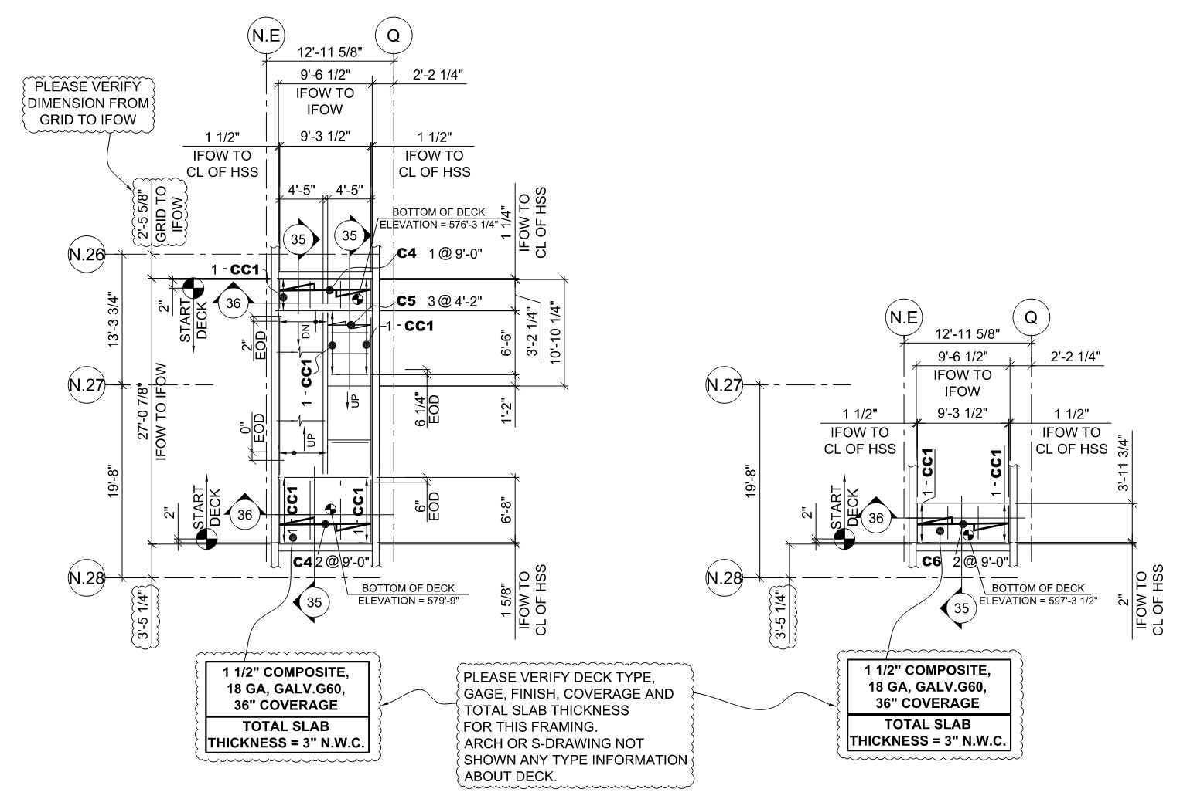
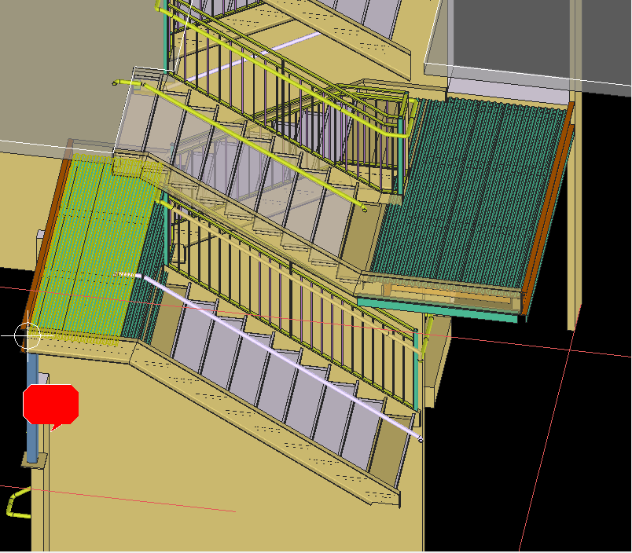
SOUTHERN METHODIST UNIVERSITY
STAIR DECK DRAWINGS
One Goal, One Passion – Synchronize with Future
www.rydbergengineering.com

Slide 25
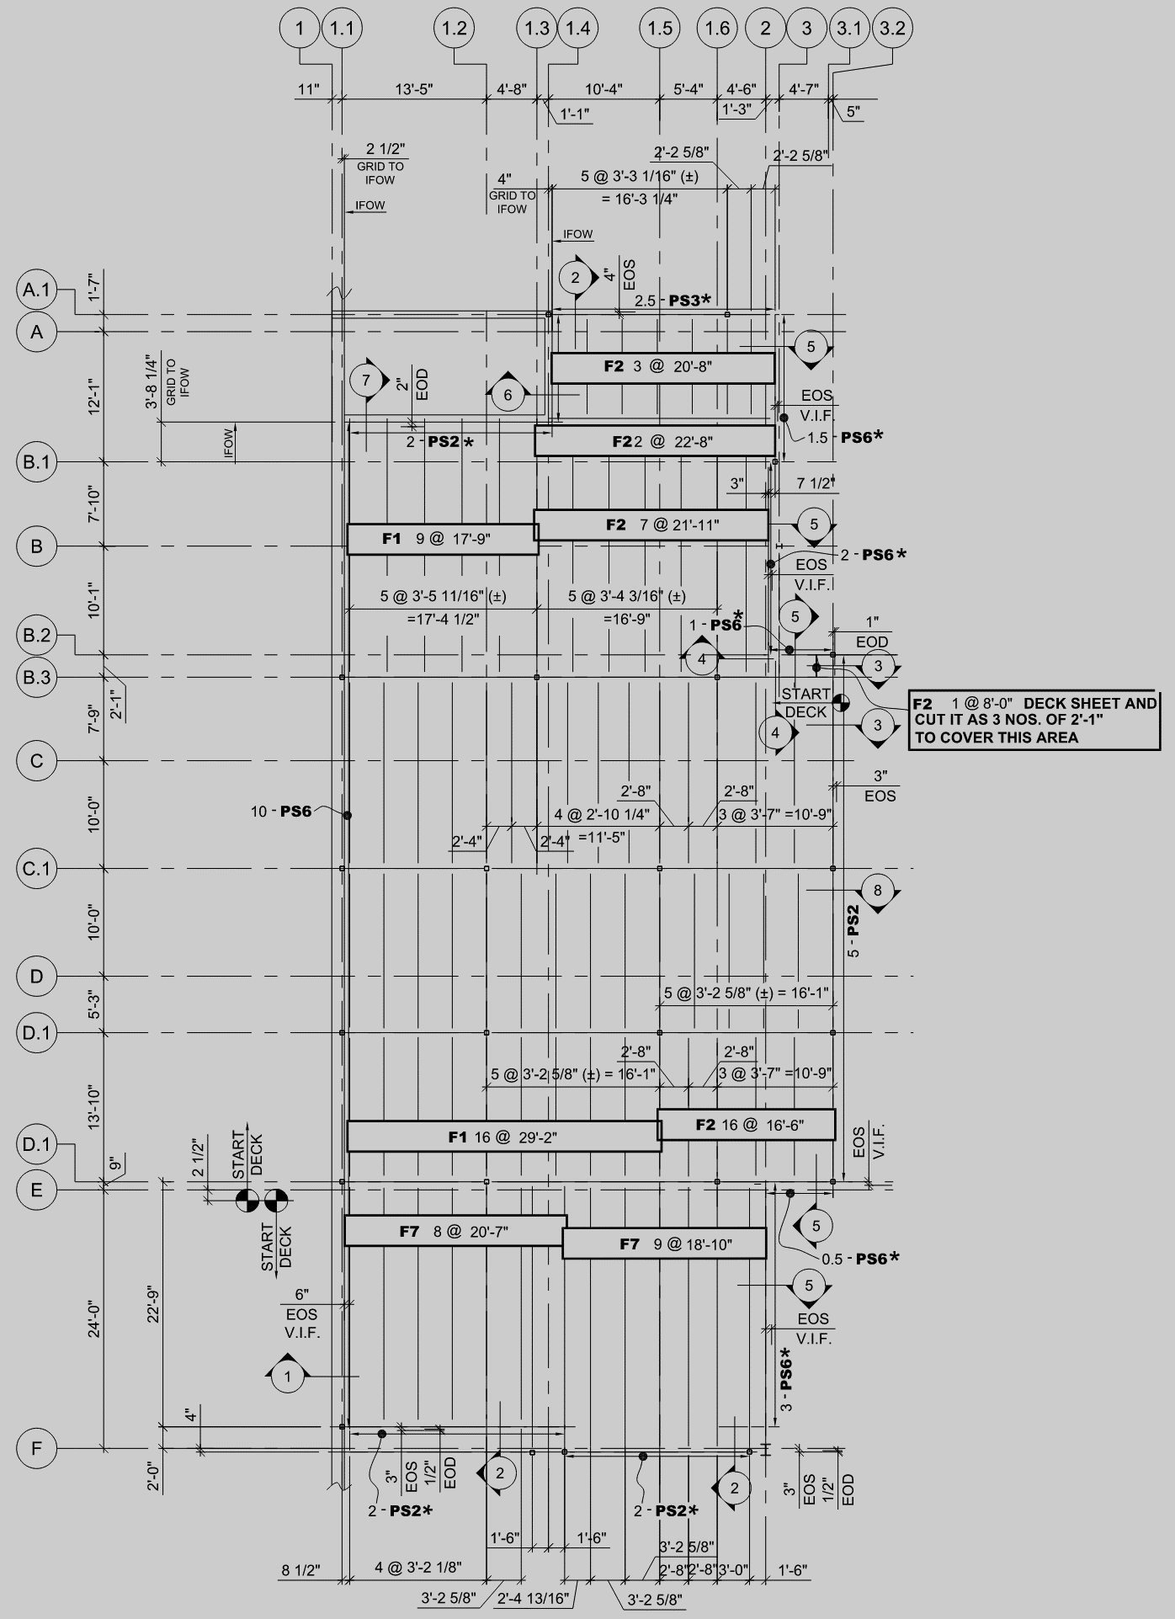




LAUREL MULTI- SERVICE CENTER- PHASE 2
FORM DECK PROJECT
One Goal, One Passion – Synchronize with Future
www.rydbergengineering.com

Slide 26

Dovetail or reveal series or versa deck
One Goal, One Passion – Synchronize with Future
www.rydbergengineering.com

Slide 27

SAMPLE Deck sections
One Goal, One Passion – Synchronize with Future
www.rydbergengineering.com

Slide 28

SAMPLE Deck sections
One Goal, One Passion – Synchronize with Future
www.rydbergengineering.com

Slide 29

SAMPLE Deck sections
One Goal, One Passion – Synchronize with Future
www.rydbergengineering.com

Slide 30



Deck fastEner scheduleS
One Goal, One Passion – Synchronize with Future
www.rydbergengineering.com

Slide 31



Deck list samples
One Goal, One Passion – Synchronize with Future
www.rydbergengineering.com

Slide 32

Deck list samples
One Goal, One Passion – Synchronize with Future
www.rydbergengineering.com

Slide 33

Deck accessories list
One Goal, One Passion – Synchronize with Future
www.rydbergengineering.com

Slide 34

ESTIMATION OF JOIST AND DECK PROJECT
OUR TEAM IS ALSO EXPERIENCED IN JOIST AND DECK PROJECTS ESTIMATION
One Goal, One Passion – Synchronize with Future
www.rydbergengineering.com

Slide 35
Our industry associates
OUR DETAILING TEAM IS QUITE EXPERIENCED WITH SERVING THE FOLLOWING JOIST AND DECK MANUFACTURERS AND FABRICATORS WITH THEIR HIGH QUALITY WORK
VULCRAFT (NUCOR)
NEW MILLENNIUM
CANAM
GOODER HENRICHSON
VALLEY JOIST
CMC JOIST
One Goal, One Passion – Synchronize with Future
www.rydbergengineering.com

Slide 36

Let’s Work Together
WE Design…
You BUILD…
Arnab Sengupta
President
arnab@rydbergengineering.com
USA – 484-531-3615
651 N. Broad St. Suite 206, Middletown DE 19709, US
One Goal, One Passion – Synchronize with The Future
http://www.rydbergengineering.com

